Slide 1
Gating strategy for the B cell populations (FACS)
The plots are from one example of a CAR mouse (day 7 post immun.)
The same gating has been used for all analyzed mice in identical way

Slide 2
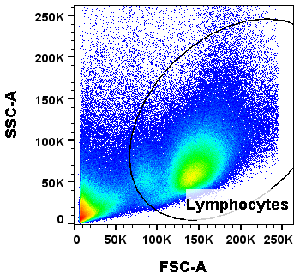
General gating strategy: Singlets -> Alive cells -> Lymphocytes
small gate for B cells
(MZB/FoB and GC)
Large gate for PC

Slide 3
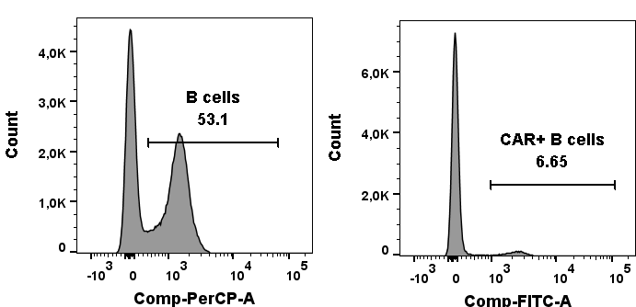
Total B cells and CAR+ fraction among B cells: (pre-gated on Singlets -> Alive cells -> Lymphocytes (small gate), slide 1)
B220
CAR

Slide 4
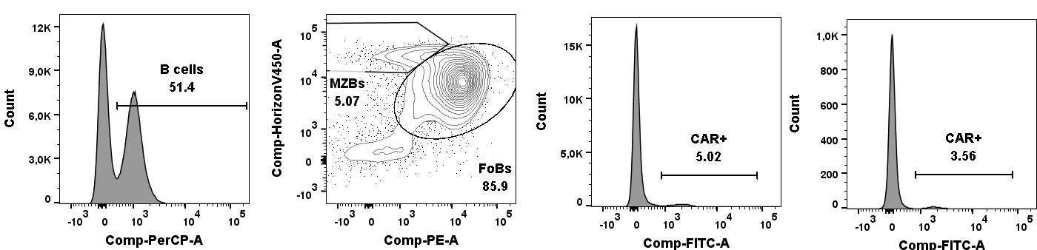
FoB/MZB cells and fraction of CAR+ cells in each subset: (pre-gated on Singlets -> Alive cells -> Lymphocytes (small gate), slide 1)
B cells
FoBs
MZBs
CD21
B220
CD23
CAR
CAR

Slide 5
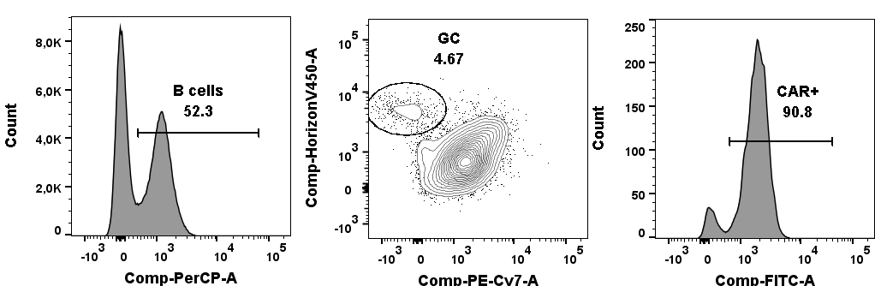
GC B cells and fraction of CAR+ cells in GC: (pre-gated on Singlets -> Alive cells -> Lymphocytes (small gate), slide 1)
B cells
GC
CD95
B220
CD38
CAR

Slide 6
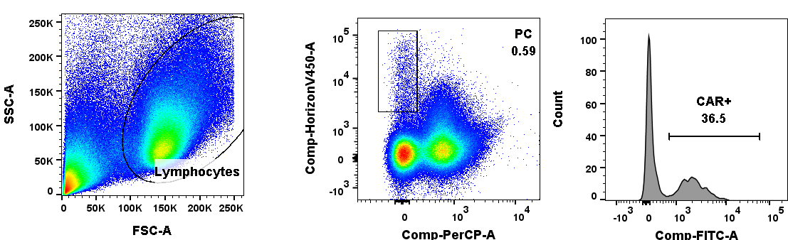
Plasma cells (PC) and fraction of CAR+ cells in PC: (pre-gated on Singlets -> Alive cells -> Lymphocytes (large gate), slide 1)
Lymphocytes
PCs
CD138
B220
CAR

